Slide 1


MEDITECH Expanse
Acute Provider Training
Web Based EHR

Slide 2

Disclaimer
This PowerPoint is NOT a full training on MEDITECH Expanse
The goal is to introduce you to the EHR and introduce you to Views and Concepts
An in-Person training session is required
  Setup Access (Along with additional Applications)
  Expand on the process details
  Tailor training to the user (Surgeon/Consultant/Hospitalist etc.)

Slide 3
Table of Contents
Expanse Login
Acute Status Board
The Chart
Document
Orders
Discharge
Slide 4
Slide 10
Slide 28
Slide 44
Slide 48
Slide 53

Slide 4
Expanse Login

Slide 5


MEDITECH Expanse
Expanse is available in 2 versions
  Desktop
    Similar to 6.15 (previous version)
    Only available version to non-Providers
  Web
    New Design
    Provider only
    Added functionality

Slide 6


Launching into Expanse Web
Double Clicking the Expanse Web icon opens a Chrome tab (Chrome is the default browser for Expanse Web)
Click “Launch New Session” to open an Expanse Web Session

Slide 7
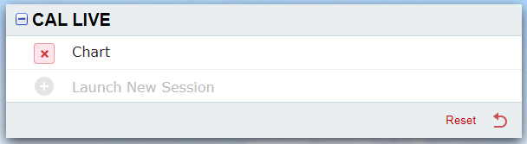
Launching into Expanse Web
If Expanse was exited incorrectly
  An option to return to previous location is offered
  That session may also be cancelled “X”, and a new session will be offered

Slide 8
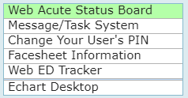
Main Menu options
Options vary based on access
“Web Acute Status Board”
  Launches Status Board
  Working area for Expanse
“Message/Task System”
  Non-Web Workload
“Change Your User’s PIN”
  Change/Set your sign PIN
“Facesheet Information”
  Ask Nurse/Secretary to provide
“Web ED Tracker”
  Optional start point for Hospitalists
“Echart Desktop”
  Functions for providers assigned to do chart reviews

Slide 9
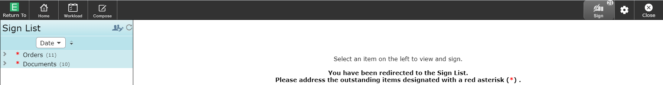
Redirect to Sign Queue
If you have items to sign, you will be redirected to your Sign Queue
  You may close, unless items are overdue
    Ordering functionality is disabled if not signed
Orders (Submit and reject options)
Documents (Submit and edit co-signers options) – Deleting is done from the chart

Slide 10
Acute STatus Board
Introduction to the Acute Status Board

Slide 11
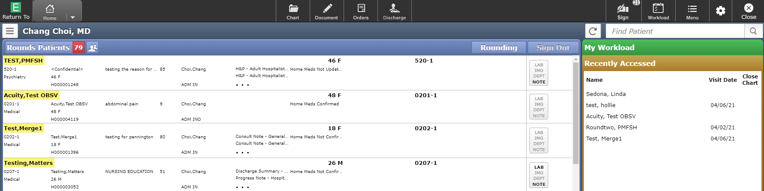
Acute Status Board View
We will systematically review the sections of the display
“Rounds Patients” is the default display

Slide 12
Home Screen Navigation Header
The Navigation header may alter slightly as options are chosen

Slide 13











Navigation Bar Buttons
Return To – Button allows you to close all open charts or completely out of Expanse. Failure to use the “Close All” option will leave your session open in the background and could contribute to system issues and slowness.
Home – The Home button will take you back to your list of patients (previous window still open). Option to toggle to Ambulatory/ED views
Chart – Opens the chart of the patient highlighted on the tracker
Document – Create or edit documents
Orders – Place or review orders, Reconcile, Transfer
Discharge – Universal Discharge
Sign – Sign queue, to sign orders or documents. Number in corner indicates the number to sign
Workload – Displays deficiencies, queries etc. Web version of “message/Task System”
Menu – Change PIN, Access External links, Manage Typical, launch chart Viewer Etc.
Gear Icon – “Report an Issue” to create snapshot when issue occurs (= “Shift” + “F5”)
Close – Closes displayed window. Can exit Expanse if all windows are closed this way

Slide 14
Provider Header
Identifies the logged in provider
Allows for patients to be search for
Refresh List
Print list and other options

Slide 15
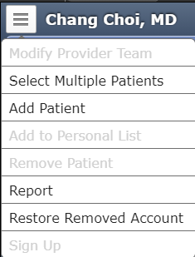
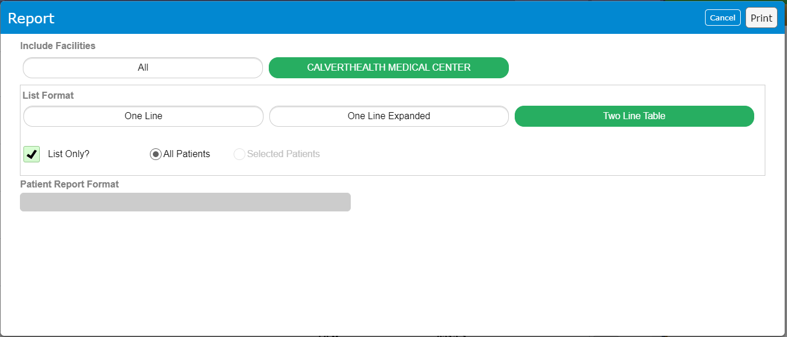
Options
While many options display
  “Report” is only recommended one
Creating Report
  Printing patient list
  Choose preferred List Format

Slide 16

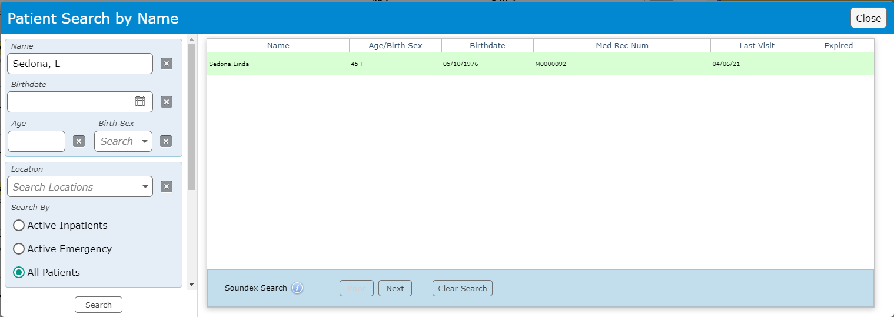
Patient Search
Enter patient name
Resulting pop-up
Filters on left pane
Select desired patient from list

Slide 17
Right Panel

Slide 18
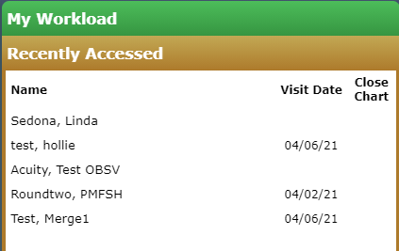
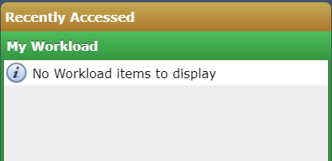
Right Panel
Recently Accessed
  Displays previously opened charts
  Most recent at the top
  Default display
My Workload
  Summary of Workload
  Snapshot of Workload screen

Slide 19
List Management
Choose which Patient list to display
Choose coverage options

Slide 20
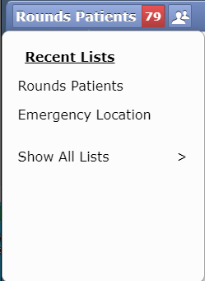
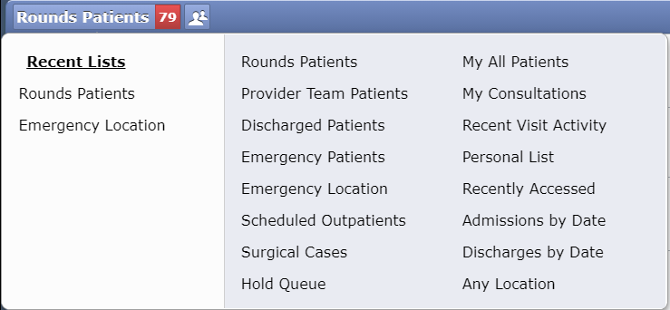
Patient Lists
“Rounds Patients” = default list
Clicking on that header opens list options
“Show All Lists” displays all options
“Recent Lists” displays last 7 selections
“Emergency Location” = Current ED list
# = patients in List

Slide 21

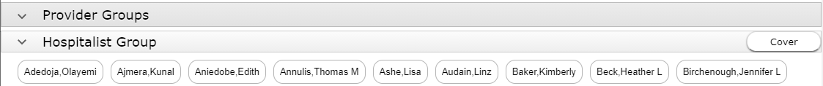
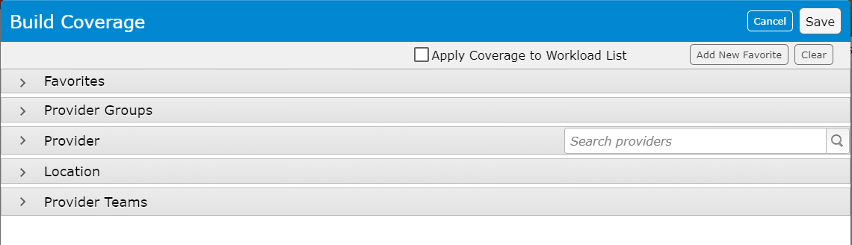
Coverage
Click on Head(s) to edit Coverage
Click on “Edit Coverage”
“Provider Groups” then Assigned “Group” displays
Click “Cover” to add the entire group
Never Choose
  “Workload”

Slide 22

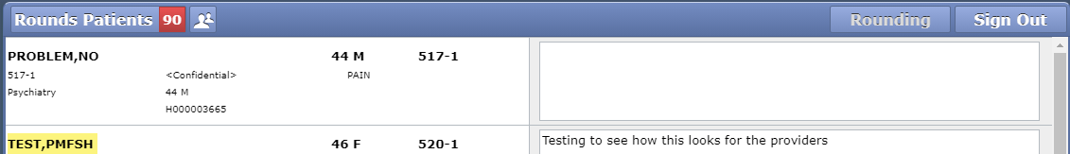
Rounding vs Sign Out
Rounding option is default
Sign Out not being used (Currently, June 2021)
Sign Out view below – Communication tool

Slide 23
Patient Box
Bold Text – Header (Name, Age, Gender etc.)
Column 1 – Room, Service, Special Indicators
Column 2 – Name, Age, Gender, Visit # (H#)
Column 3 – Visit Reason, Visit length
Column 4 – Admitting provider, Status
Column 5 – Provider documents (… = More)
Column 6 – Home Med/Med Rec Status
Column 7 – (No display this patient) Sepsis Indicator, Etc.
Column 8 – Activity Log Button

Slide 24

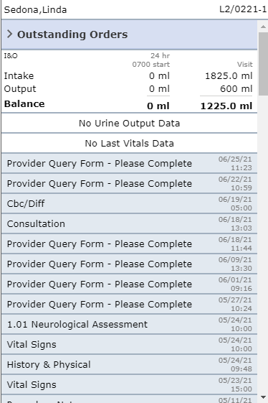
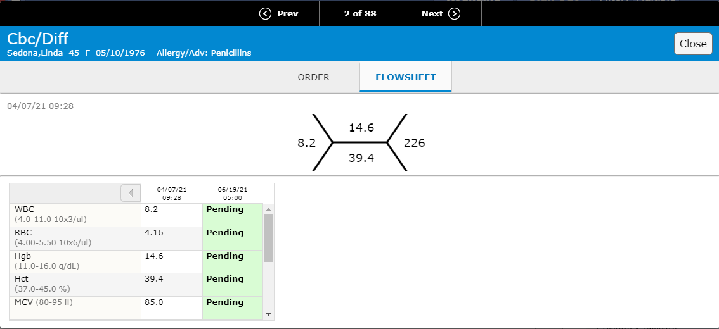
Activity Log Button
Text may be red, bold, or grey (low lit)
Clicking on button opens Activity Log
  Replaces Recent Patient/Workload panel
I&O and Critical Labs display open
All items can be opened to Popup

Slide 25
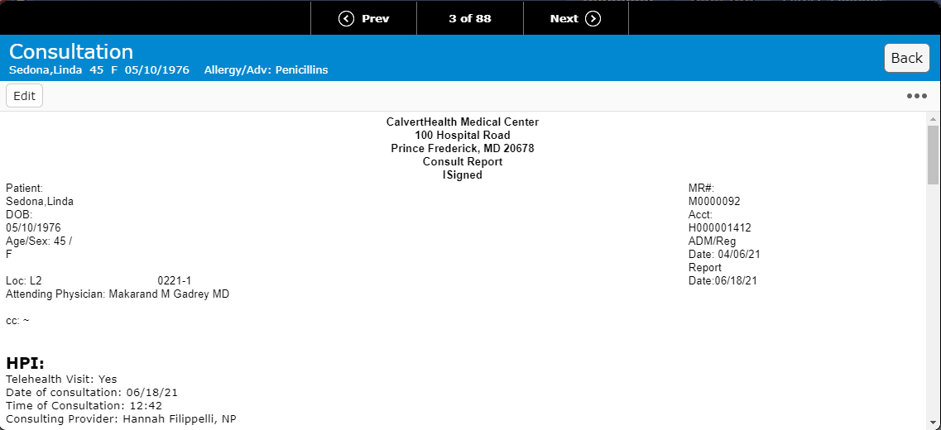
Activity Log
Toggle through activities, “Back” to close popup

Slide 26
Activity Log
Clicking into Status board closes Activity Log view

Slide 27
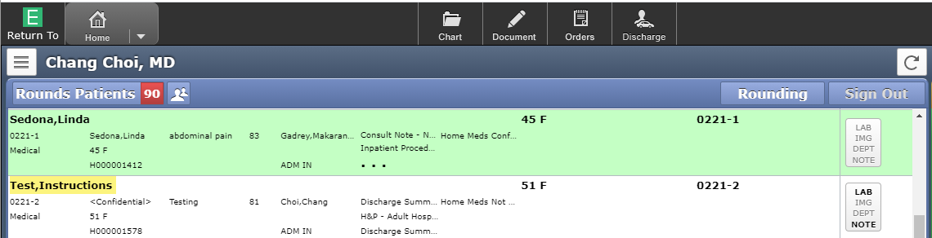
Action Buttons
The Highlighted patient (Sedona, Linda) can have all 4 Action Buttons used
Clicking the “header” name (Test, Instructions) will open the chart
  Once in the chart the other buttons are available to click

Slide 28
The Chart
Chart Navigation

Slide 29
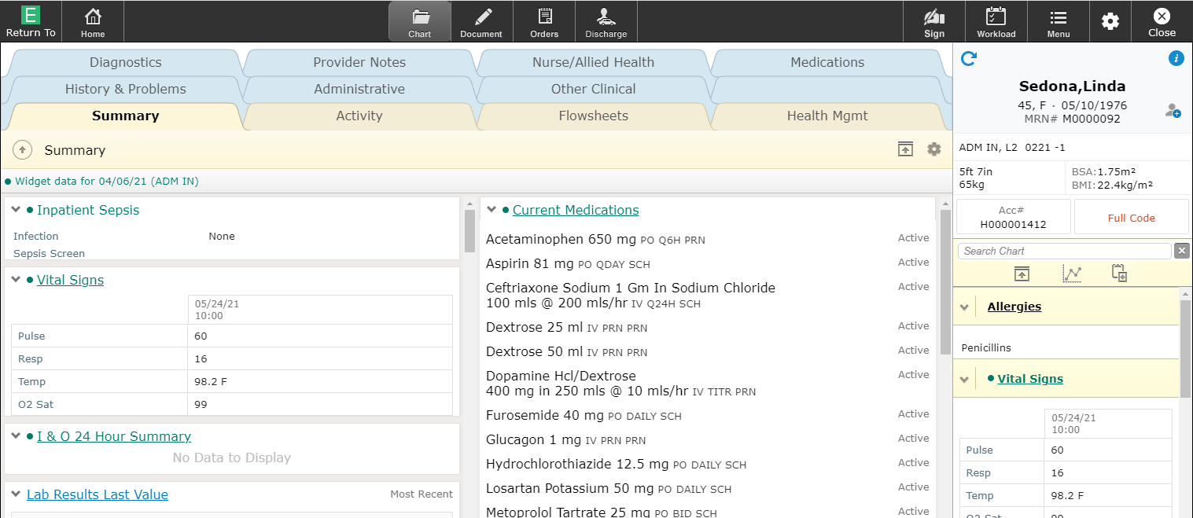
Chart Overview
Chart in Tab View (Left) – Varies based on Tab selected
Reference Panel (Right) – Always open

Slide 30
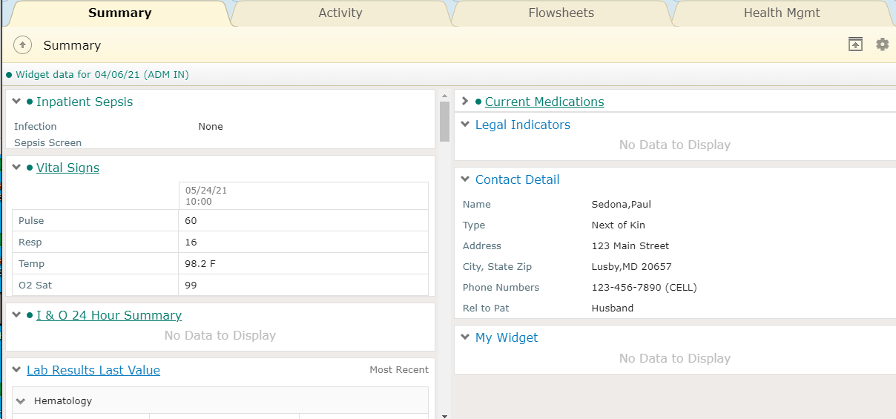
Summary Tab
Collection of Widgets in 2 columns
Click Cogwheel to Edit Widgets

Slide 31
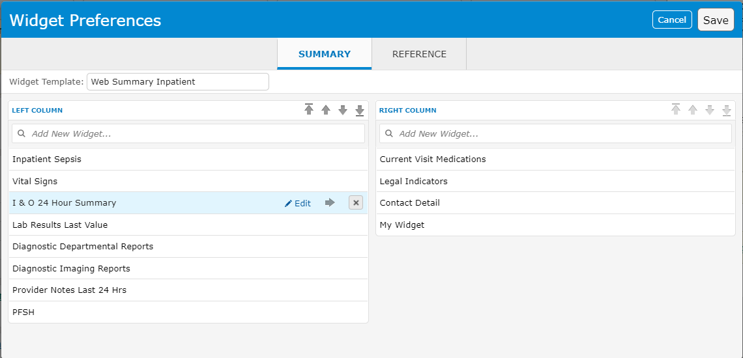
Widget Preferences
Widgets may be
  Added
  Deleted
  Moved (to different column or within list)
**Never Edit**

Slide 32
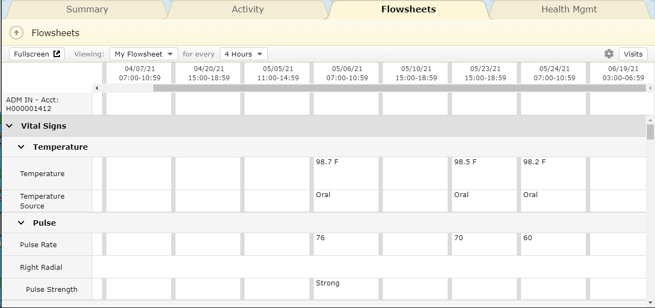
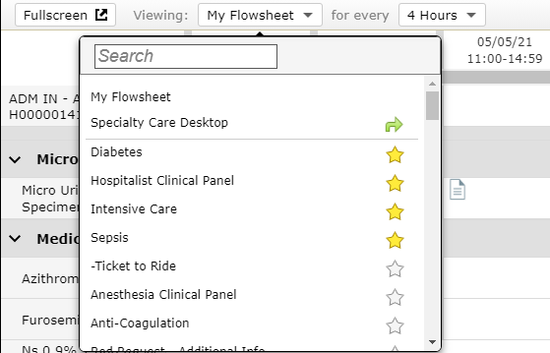
Activity/Flowsheets/Health Mgmt
Activity – Activity Log (Seen previously)
Health Mgmt – Ambulatory, not used
Flowsheets – VS, I&O, Pain levels, Labs, Meds Given
  Other “Clinical Panels” may be chosen
Yellow star = Favorite

Slide 33
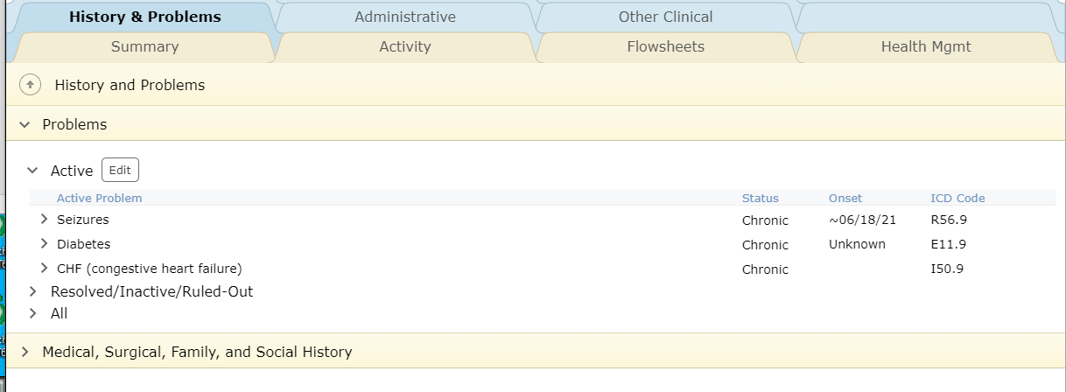
History & Problems/Administration/Other Clinical
History & problems
  Review screen of Problem List
  Better process to Edit within Documents

Slide 34
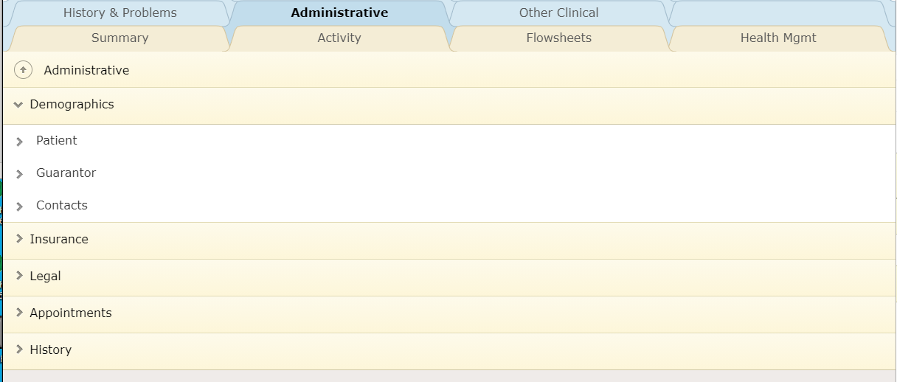
History & Problems/Administration/Other Clinical
Administrative – Registration Information
  “Legal” – Includes MOLST form Hx

Slide 35
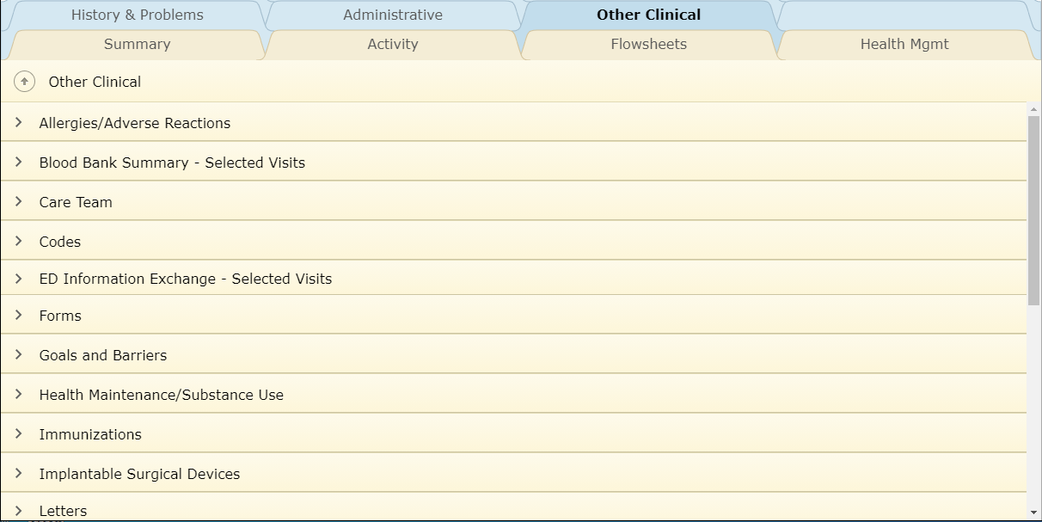
History & Problems/Administration/Other Clinical
Other Clinical
  A collection of all information that didn’t have a designated tab location

Slide 36
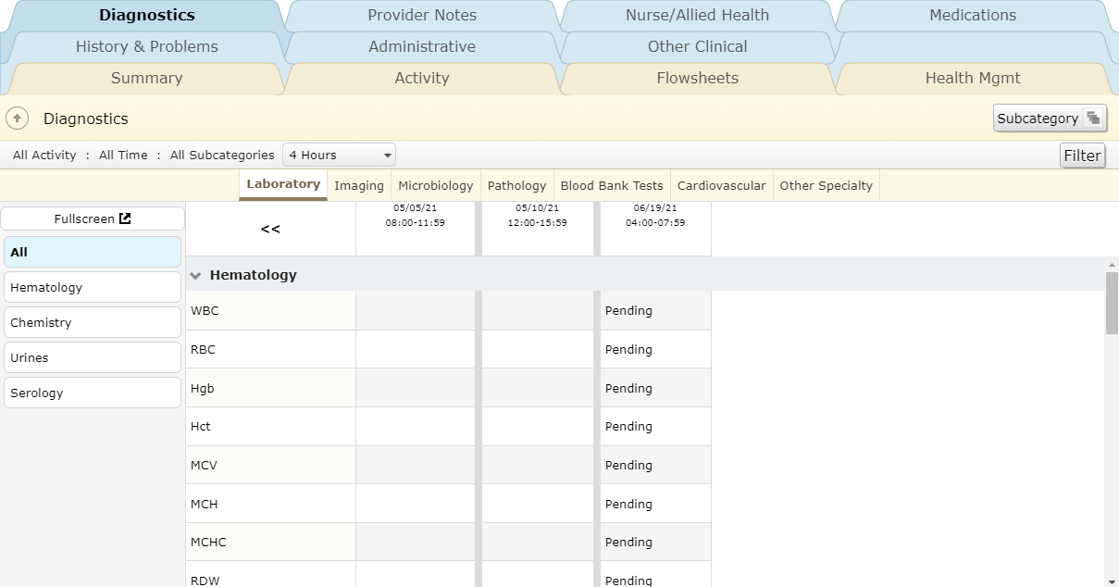
Diagnostics/Provider Notes/Nurse/Allied Health/Medications
Diagnostics
  Click on headers to see specific Specialties
  Left Panel filters view under Lab
Subcategory – best view
  Microorganism- alternative view
Filter – time range/ Inpatient/ subcategory

Slide 37
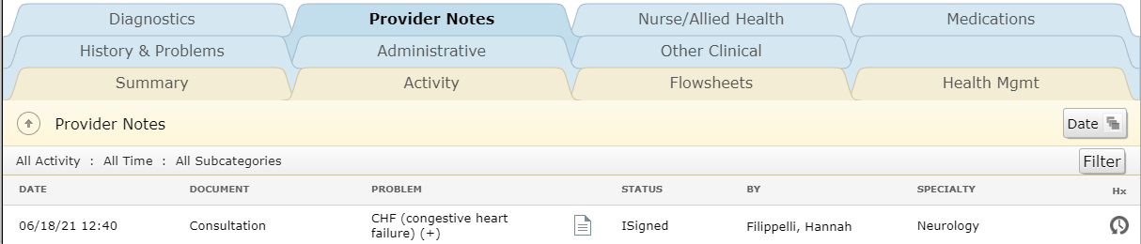
Diagnostics/Provider Notes/Nurse/Allied Health/Medications
Provider Notes
  All Provider Notes display here
  All statuses included (Signed/Draft/Pending)
  Click document icon to open and view document
    Document icon will display a “✓” when viewed

Slide 38
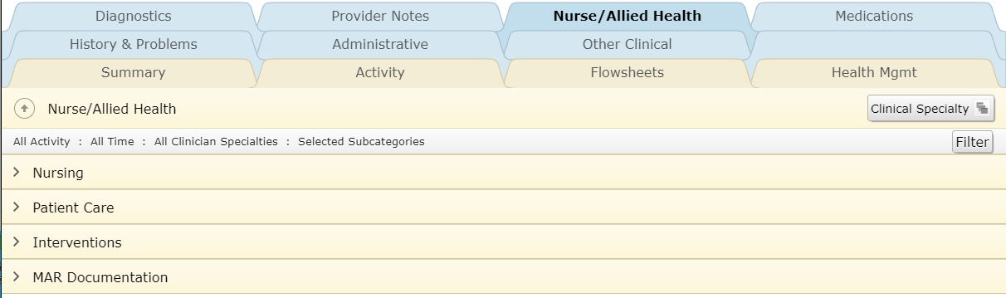
Diagnostics/Provider Notes/Nurse/Allied Health/Medications
Nurse / Allied health
  All non-provider assessments/notes appear here

Slide 39
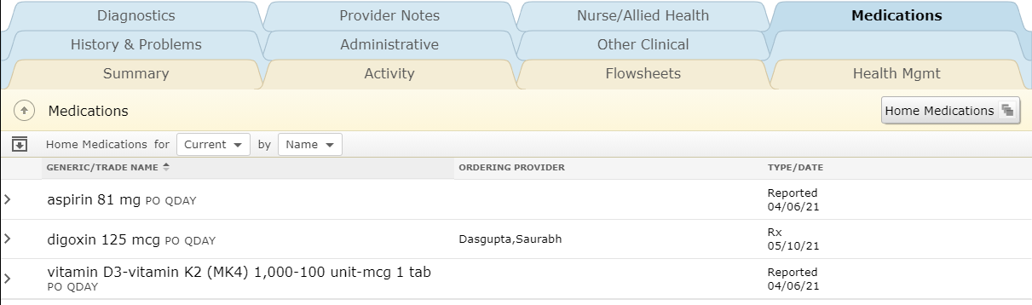
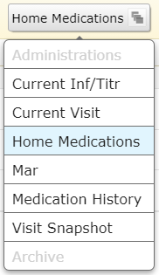
Diagnostics/Provider Notes/Nurse/Allied Health/Medications
Medications
  All medication views are found here

Slide 40
Reference Panel
Patient information that constantly displays
Name/Age/Gender/DOB/Medical Record #
Status/Floor/Room
Height/Weight
  Calculated BSA/BMI
Acct# Button
  Click to select Visit(s)
Resuscitation Status Button
  Displays Code Status (Hx available(?) if not ordered)
  Link to code Status Hx/MOLST Hx
  Able to order/edit Code Status from linked page

Slide 41
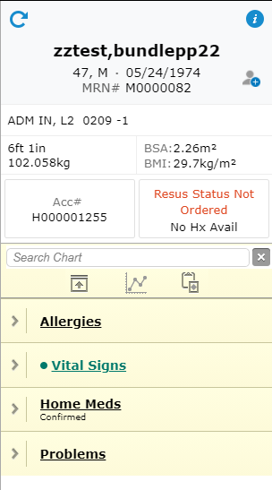
Reference Panel
Search Chart
Locked Widgets
  Collapsed here to display them

Slide 42
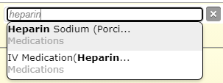
Chart Search
Search Chart
  Type any element in chart (must exist in chart)
  Clickable options display
  Popup results display

Slide 43
Reference Panel Widgets
Box with up arrow
  Collapses and expands widgets
Click Widget Header for more detail
Widget editor (cogwheel on Summary)
  Can add widget(s) below locked 4
**Recommended to always
leave Allergies open**

Slide 44
Document
Introduction to the Document

Slide 45
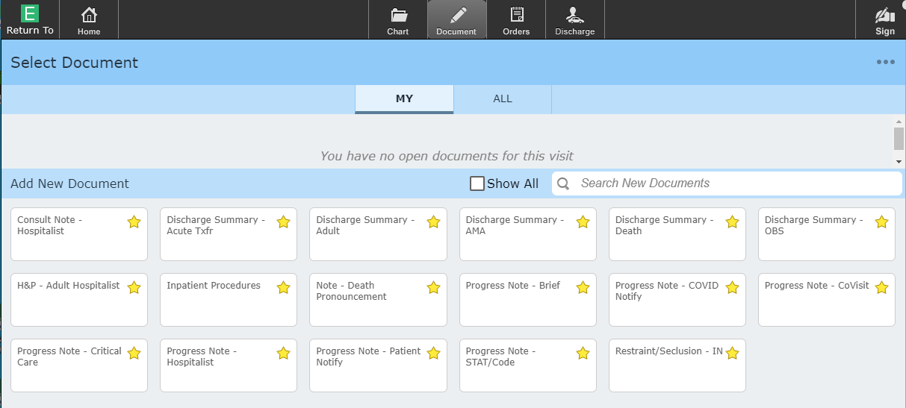
Document
Favorite Documents display (yellow star) to select
Existing (Draft/Pending) display in Grey area under “MY”

Slide 46
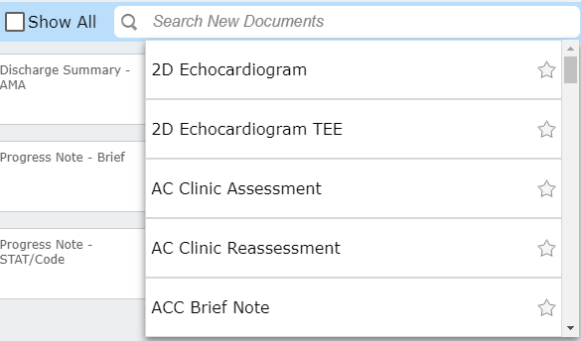
Document
“Show All” – displays all documents with favorites at the top
“Search New Documents” – Displays all documents alphabetically
  Click on Star to make it a favorite

Slide 47
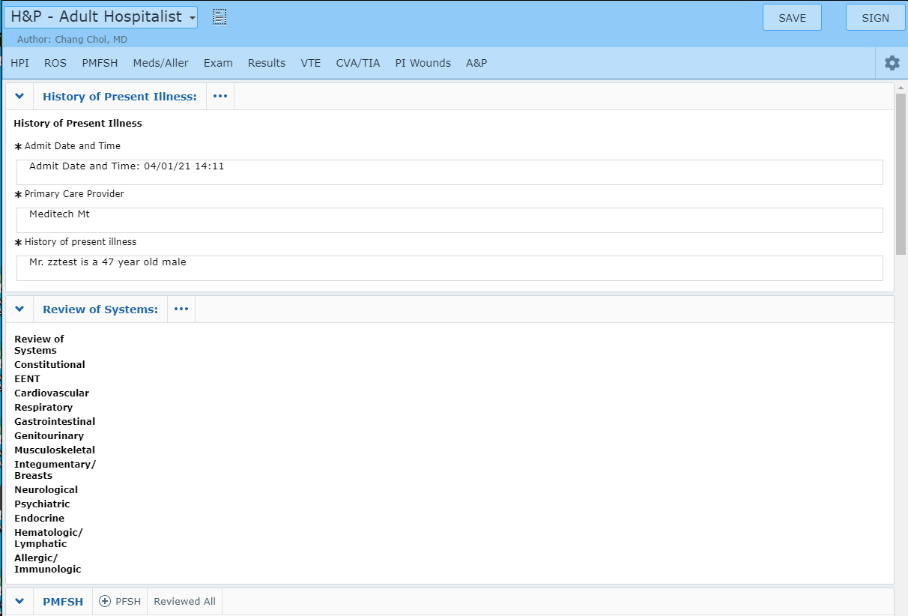
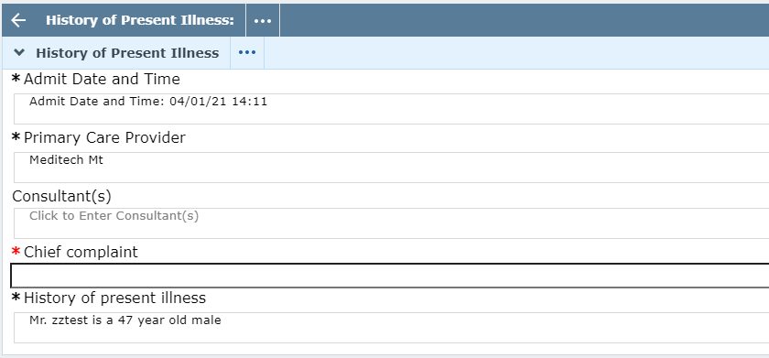
Document
Training on Document details will be done in person
  Header links jump to that location in chart
  Clicking section headers opens them for editing
  HPI shown below in Edit mode (note arrow)
  Save (draft) and Sign options

Slide 48
Orders
Introduction to the Orders screen

Slide 49
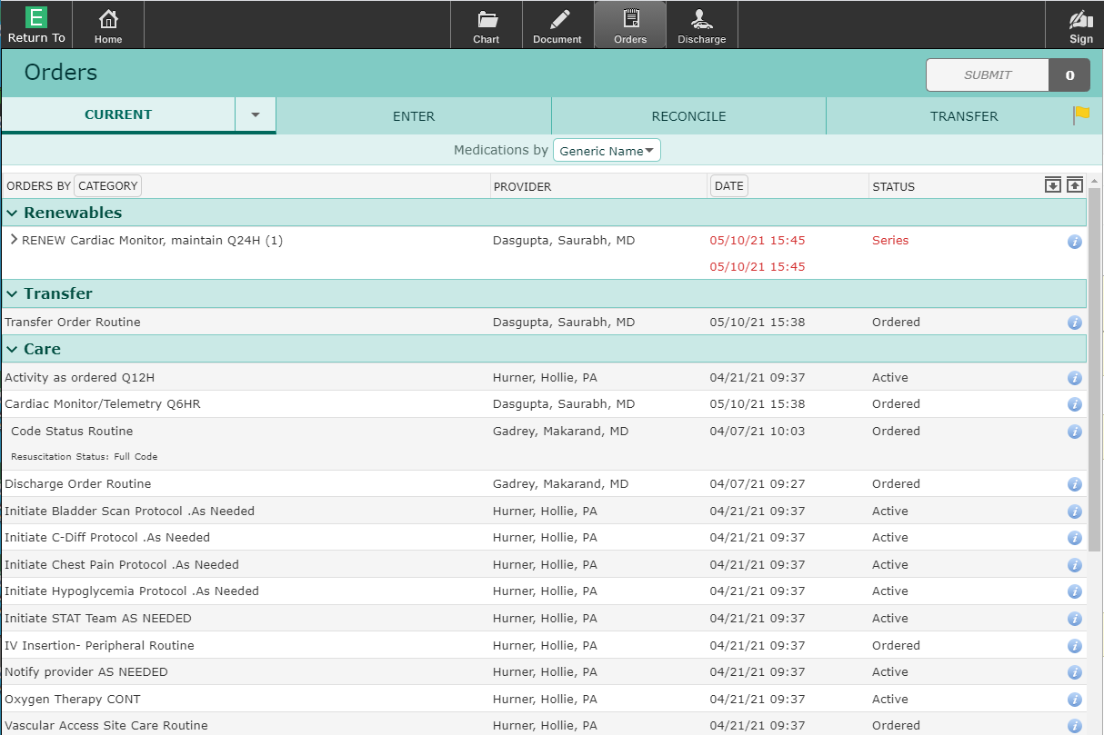
Orders
Current/Enter/Reconcile/Transfer headers display
Drop arrow by Current – Historical and Hold Queue
Yellow Flag on Transfer header – existing orders
Display is “Current
Orders” by category

Slide 50
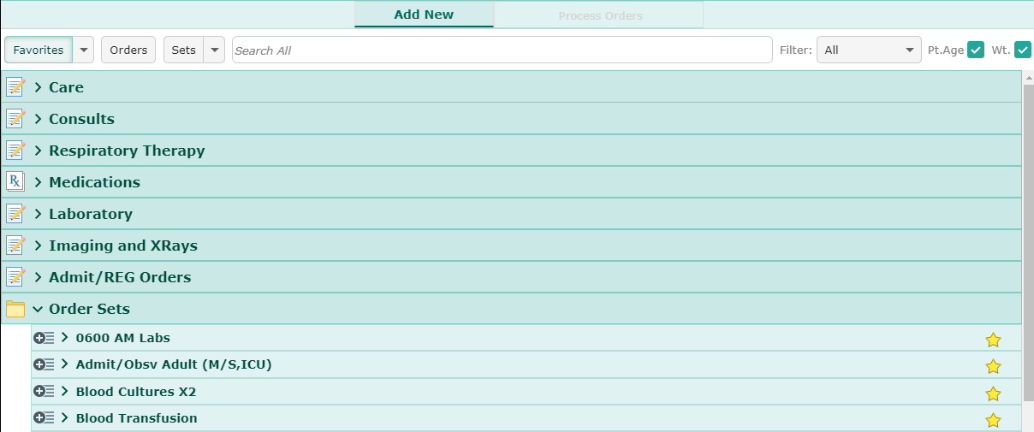
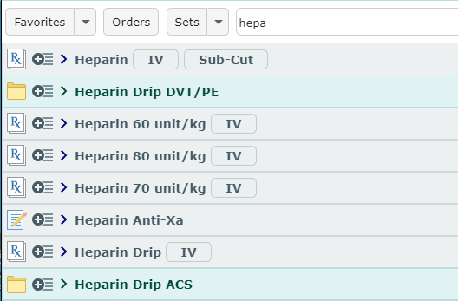
Enter Orders
Default display is “Favorites” (Category)
“Orders” button display all orders by category (collapsed)
“Sets” displays all order sets (May be sorted)
Search displays options (orders/medications/sets)
  When options are not too large
  Heparin search below

Slide 51
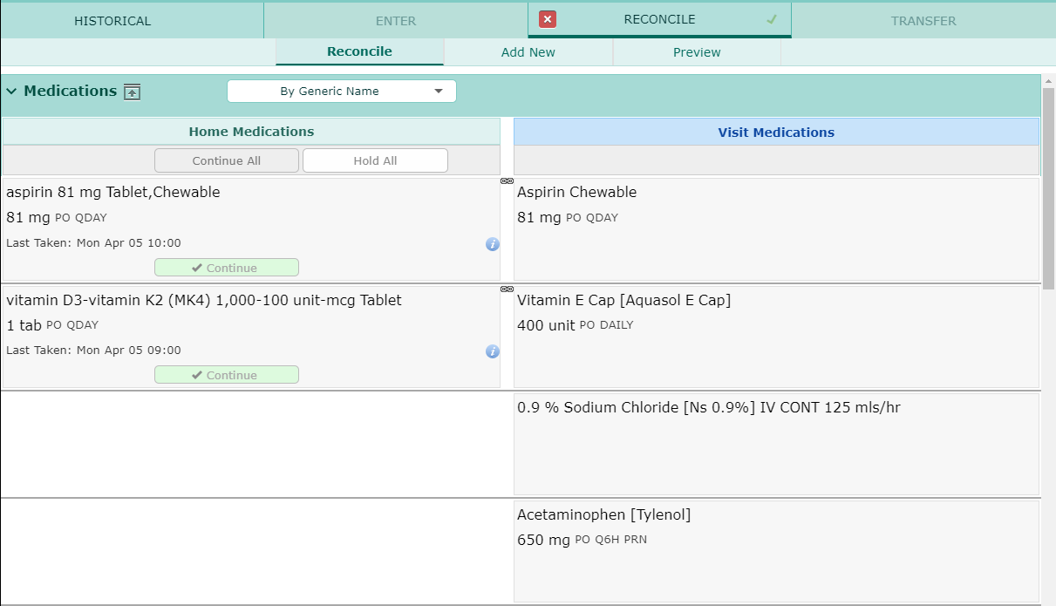
Reconcile
Only done by Admitting providers
Usually done within the Transfer Routine

Slide 52
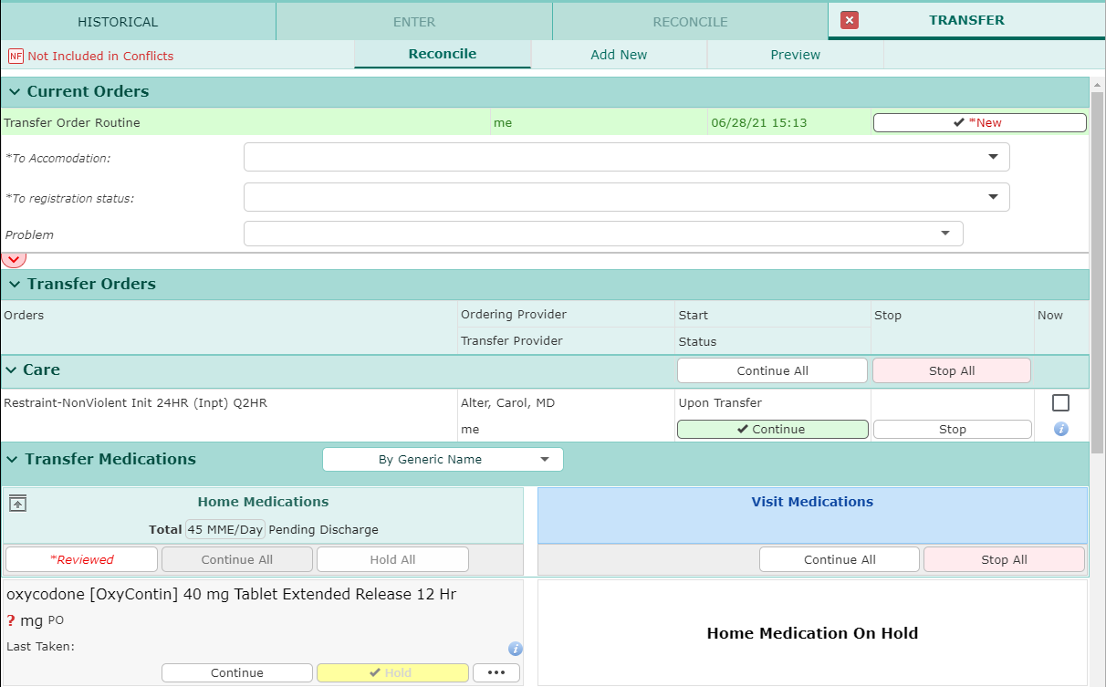
Transfer Routine
Used to transfer patients when level of care changes
Entered as pending orders (Receiving nurse activates)
Transfer order (Registration order)
Existing orders
  Stop/continue
Med Reconciliation
New orders added

Slide 53
Discharge
Introduction to Universal Discharge
Varies based on Patient location (SDS, ED, Admitted)

Slide 54
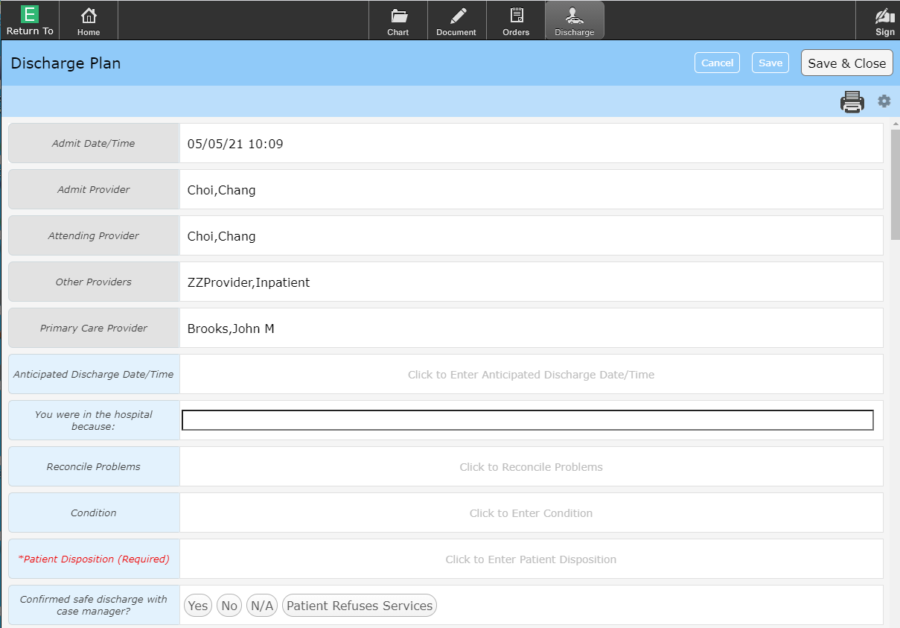
Universal Discharge
Universal Discharge – All clinicians have input into the discharge process
The “Discharge” exists in 2 locations (identical in both locations)
  Under the “Discharge” button
  Discharge Summary Documents
*Red = Required
Grey = Not available
  Based on user

Slide 55
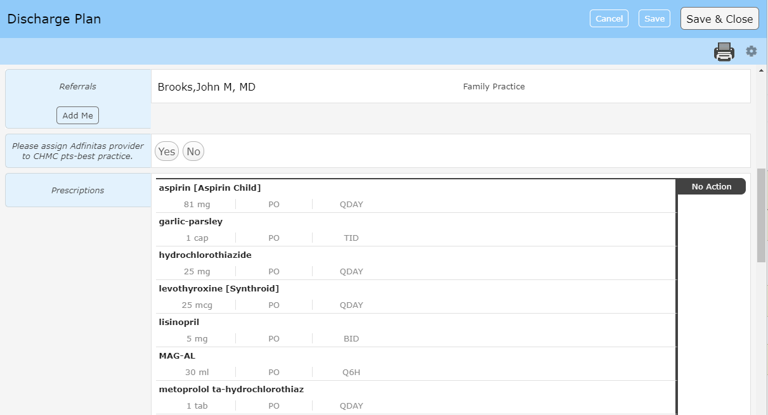
Universal Discharge
Referrals
Discharge Medication Reconciliation
  New Rx’s
Discharge order (not shown)

Slide 56

Thank You
You should have been scheduled for 1 on 1 training
Please call (410)535-8260 or email glenn.heaney@calverthealthmed.org if you have questions

